Slide 1
Smart Plant Health Assistant Using CNN and NLP for Disease Detection
SAI CHAITANYA(TEAM LEADER)
SHIKHA PANDEY
KAVYA KASAM
SAIPRASAD GENTEM
ARAV HANSHIK
THILAK KUMAR

Slide 2
ABSTRACT
Project Overview: This project focuses on developing an integrated system for detecting and diagnosing plant diseases using AI technologies.
Image Analysis: A Convolutional Neural Network (CNN) is used to analyze plant images and identify diseases with high accuracy.
Text Generation: A GPT-2 model generates detailed descriptions of the detected diseases, including symptoms, causes, and treatment methods.
Text-to-Speech: The generated descriptions are converted into speech, allowing users to receive audible information on disease management.
Question Answering: A question-answering system is implemented to provide specific answers to user queries about plant diseases.
Web Application: The entire system is deployed as a web-based application, making it accessible to farmers and agricultural professionals.
Impact: Provide a user-friendly tool to help manage and mitigate plant diseases, ultimately aiming to improve crop health and productivity.

Slide 3
PROBLEM STATEMENT
Challenge: Farmers and agricultural professionals often struggle to identify and manage plant diseases quickly and accurately. Traditional methods of diagnosing plant diseases can be time-consuming and require expert knowledge.
Solution Needed: There is a need for an automated system that can:
Detect Plant Diseases: Quickly identify plant diseases from images of plant leaves.
Provide Disease Information: Generate detailed descriptions of each disease, including symptoms, causes, and treatments.
Answer Questions: Offer answers to specific questions about plant diseases.
Convert Text to Speech: Provide audible descriptions to assist users who prefer listening over reading.
Goal: Develop a comprehensive web-based tool that uses AI technologies to make plant disease detection and management easier, faster, and more accessible for users.

Slide 4
DATASET
Purpose: To train and evaluate the plant disease detection model.
Format: Images with labels indicating plant types and disease status.
Categories and Labels:
Apple: Scab, Black Rot, Cedar Apple Rust, Healthy
Blueberry: Healthy
Cherry: Powdery Mildew, Healthy
Grape: Black Rot, Esca, Leaf Blight, Healthy
Peach: Bacterial Spot, Healthy
Pepper: Bacterial Spot, Healthy
Potato: Early Blight, Late Blight, Healthy
Tomato: Various diseases including Bacterial Spot, Early Blight, and more, Healthy

Slide 5
METHODOLOGY
Data Collection: We collected images of various plant diseases and healthy plants, categorized into different plant types and diseases.
Data Preparation: The collected images were labeled and preprocessed. This involved resizing the images, normalizing pixel values, and augmenting the dataset to improve model robustness.
Model Development: We used a Convolutional Neural Network (CNN) for image classification. The model was trained on the labeled images, with performance evaluated using accuracy and loss metrics.
Integration: For enhanced functionality, we incorporated NLP to generate detailed descriptions of plant diseases using GPT-2. Additionally, we converted these descriptions to speech for accessibility.
Deployment: The trained model and integrated features were deployed on Azure, enabling real-time plant disease detection and information delivery.

Slide 6
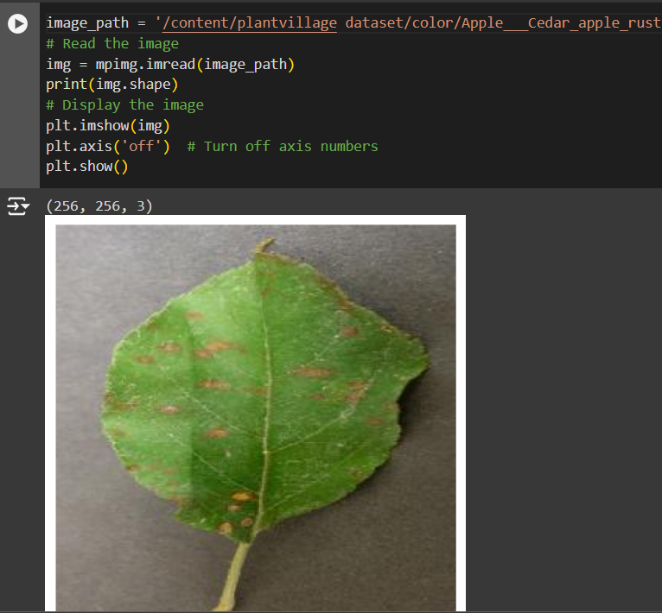
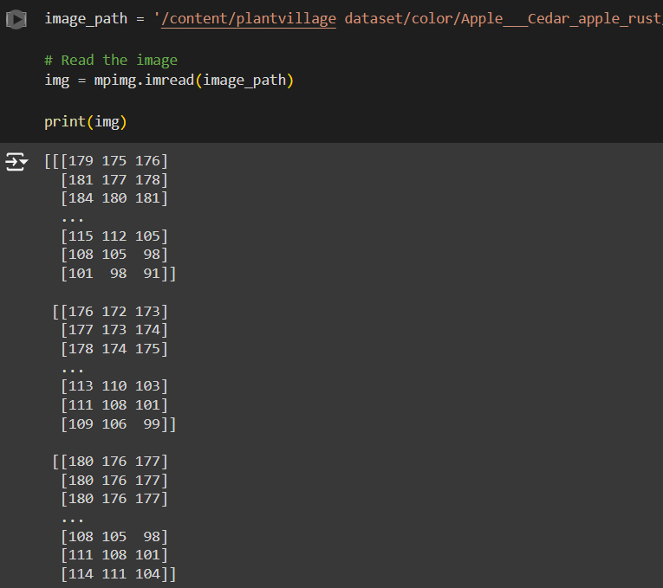
DATA PREPARATION

Slide 7
INTRODUCTION TO CNN (Convolutional Neural Networks)
A Convolutional Neural Network (CNN) is a type of deep learning model designed to analyze visual data, like images.
CNNs use layers of filters (called convolutional layers) to automatically detect patterns in images, such as edges, shapes, and textures.
CNNs are highly effective in recognizing objects and features in images, making them ideal for tasks like image classification, object detection, and medical image analysis.
CNNs are used in various fields, including self-driving cars, facial recognition, and, in our project, detecting plant diseases from images.

Slide 8
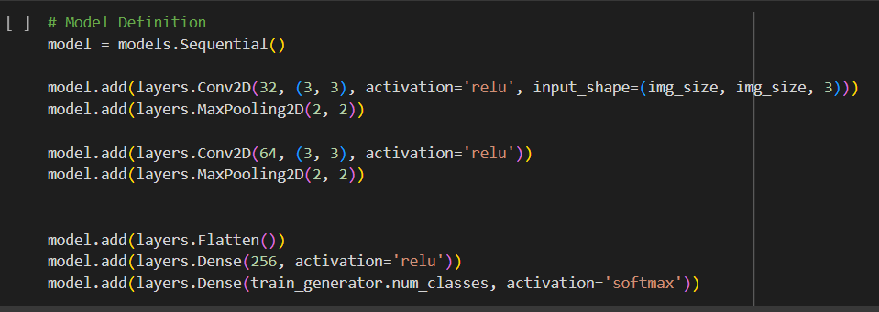
Convolutional Neural Networks
WORKING MODEL OF CNN

Slide 9
INTRODUCTION TO STREAMLIT
Streamlit is an open-source Python library that enables you to create interactive web applications for data science and machine learning projects.
With Streamlit, you can quickly build intuitive and visually appealing user interfaces directly from your Python scripts, allowing you to showcase your data analysis and machine learning models effortlessly.
It simplifies the process of developing and deploying web applications, making it accessible to both beginners and experienced developers.
pip install streamlit
streamlit run your_script.py

Slide 10
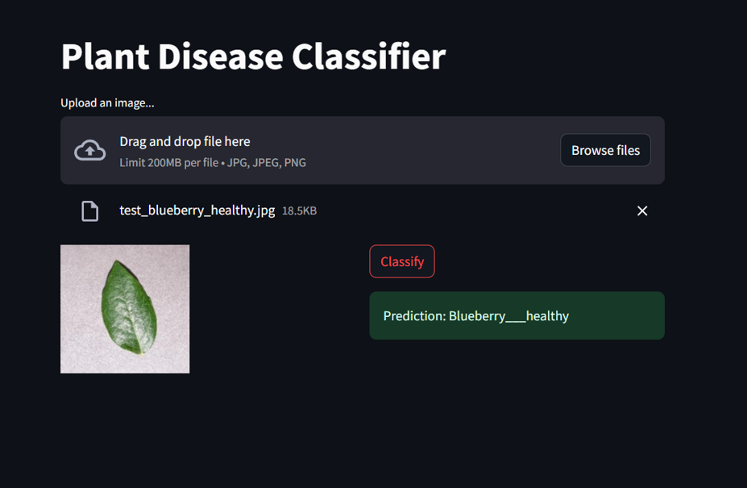
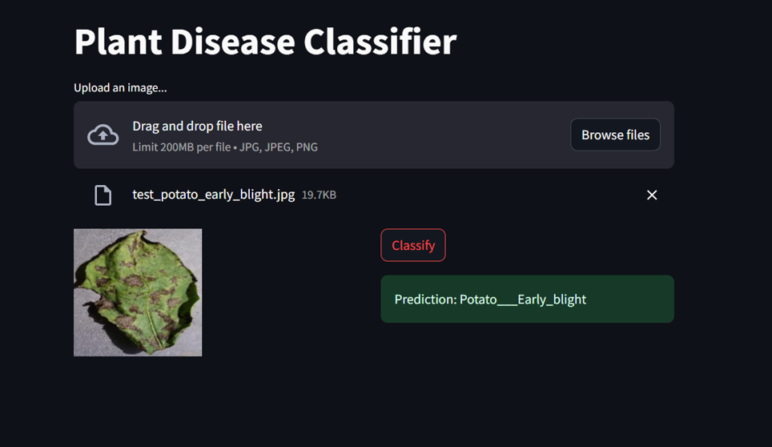
RESULTS
OUTPUT A
OUTPUT B

Slide 11
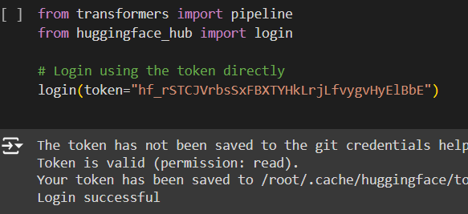
INTRODUCTION TO NATURAL LANGUAGE PROCESSING(NLP)
NLP is a branch of artificial intelligence focused on enabling computers to understand and interact with human language.
Text Analysis: Extracts meaningful information from text, like identifying sentiments and key entities.
Speech Recognition: Converts spoken language into text for voice commands and transcription.
Text Generation: Produces human-like text based on prompts, useful for chatbots and content creation.
NLP Uses techniques like tokenization, parsing, and semantic analysis.
Employs advanced models such as transformers (e.g., BERT, GPT) for understanding and generating language.
HUGGING FACE

Slide 12
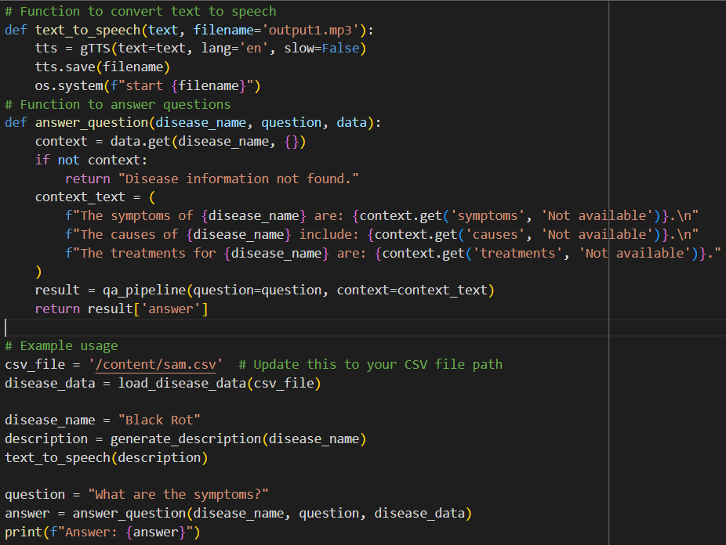
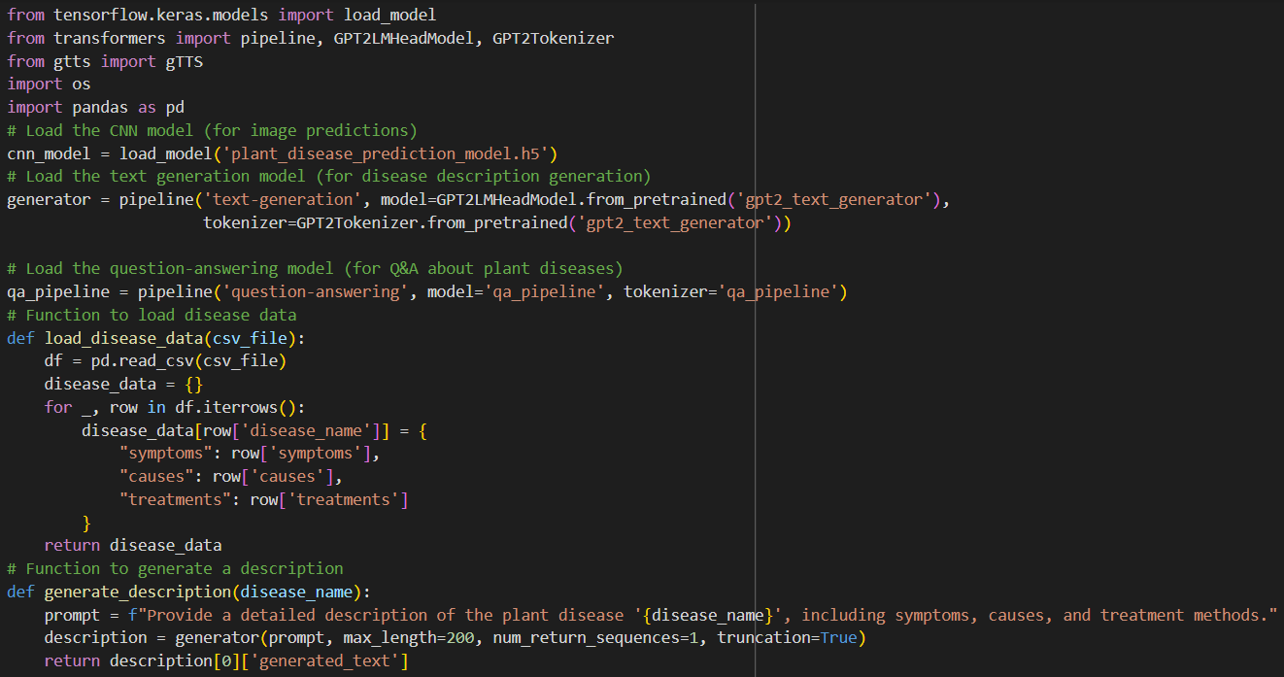
NATURAL LANGUAGE PROCESSING
WORKING MODEL OF NLP

Slide 13
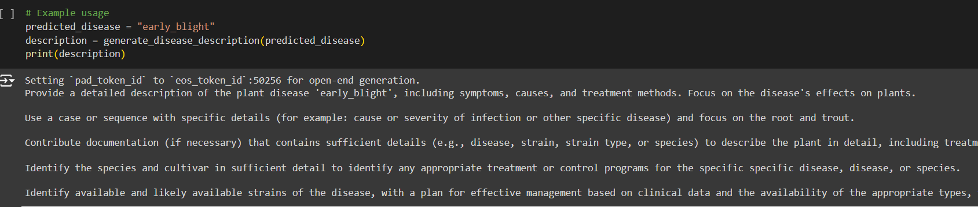
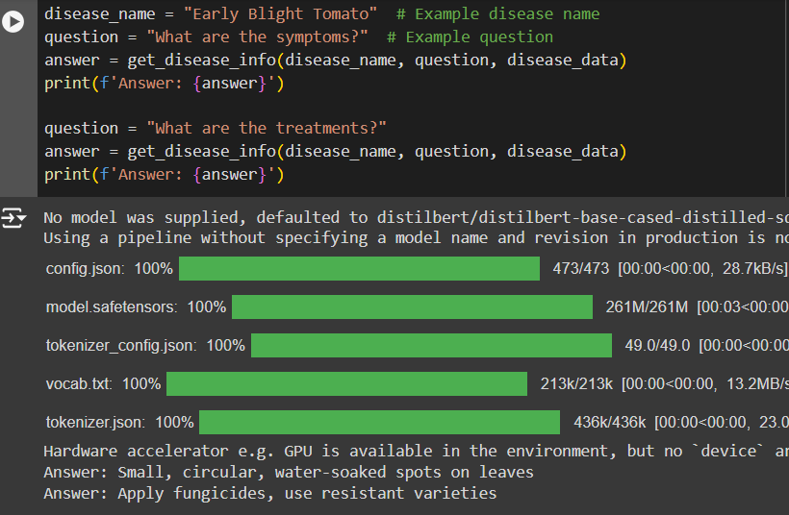
Results
OUTPUT OF PLANT DISEASE DESCRIPTION
OUTPUT OF QUESTIONING - ANSWERING

Slide 14
Conclusion
Accurate Disease Detection: Achieved a high accuracy of 96.77% on training data and 87.69% on validation data, demonstrating the effectiveness of our CNN-based model in identifying plant diseases.
Enhanced User Interaction: Utilizes NLP for generating detailed disease descriptions and answering user queries, providing a comprehensive and user-friendly experience.
Innovative Integration: Combines image classification and natural language processing to offer a smart solution for plant health management, integrating text-to-speech for accessibility.
Future Directions: Potential for further improvements with additional datasets, real-time monitoring, and expanded disease coverage to enhance overall system performance and applicability.

Slide 15


